Slide 1

Student Development Coordinator Hiring Test Revou
Audi Rivai

Slide 2

Customer Personality Analysis
Customer personality analysis is a thorough examination of a business' ideal clients. Businesses can more easily adjust products to the unique demands, inclinations, and concerns of various consumer types as a result of improved customer understanding.

Slide 3
Methodology
Data Preparation.
1
Exploration Data.
2
Data Preprocessing.
3
Data Analysis.
4
Recommendation.
5

Slide 4


problem
Customer personality analysis enables a company to change its product based on its target customers from various customer categories. Instead of paying money to promote a new product to every client in the firm's database, a company may determine which customer group is most likely to purchase the product and then market the product just to that segment.

Slide 5
Data Preparation
People
ID: Customer's unique identifier
Year_Birth: Customer's birth year
Education: Customer's education level
Marital_Status: Customer's marital status
Income: Customer's yearly household income
Kidhome: Number of children in customer's household
Teenhome: Number of teenagers in customer's household
Dt_Customer: Date of customer's enrollment with the company
Recency: Number of days since customer's last purchase
Complain: 1 if the customer complained in the last 2 years, 0 otherwise
Products
MntWines: Amount spent on wine in last 2 years
MntFruits: Amount spent on fruits in last 2 years
MntMeatProducts: Amount spent on meat in last 2 years
MntFishProducts: Amount spent on fish in last 2 years
MntSweetProducts: Amount spent on sweets in last 2 years
MntGoldProds: Amount spent on gold in last 2 years

Slide 6
Data Preparation
Promotion
NumDealsPurchases: Number of purchases made with a discount
AcceptedCmp1: 1 if customer accepted the offer in the 1st campaign, 0 otherwise
AcceptedCmp2: 1 if customer accepted the offer in the 2nd campaign, 0 otherwise
AcceptedCmp3: 1 if customer accepted the offer in the 3rd campaign, 0 otherwise
AcceptedCmp4: 1 if customer accepted the offer in the 4th campaign, 0 otherwise
AcceptedCmp5: 1 if customer accepted the offer in the 5th campaign, 0 otherwise
Response: 1 if customer accepted the offer in the last campaign, 0 otherwise
Place
NumWebPurchases: Number of purchases made through the company’s website
NumCatalogPurchases: Number of purchases made using a catalogue
NumStorePurchases: Number of purchases made directly in stores
NumWebVisitsMonth: Number of visits to company’s website in the last month

Slide 7

Exploration data Highlight
There are 2240 Customers in the company
Average Customer Income is $ 52,238.00
Total of website visits in the last month is 11909
Total Sales are $1,4 Million
Total Number of Item Purchases are 33291

Slide 8
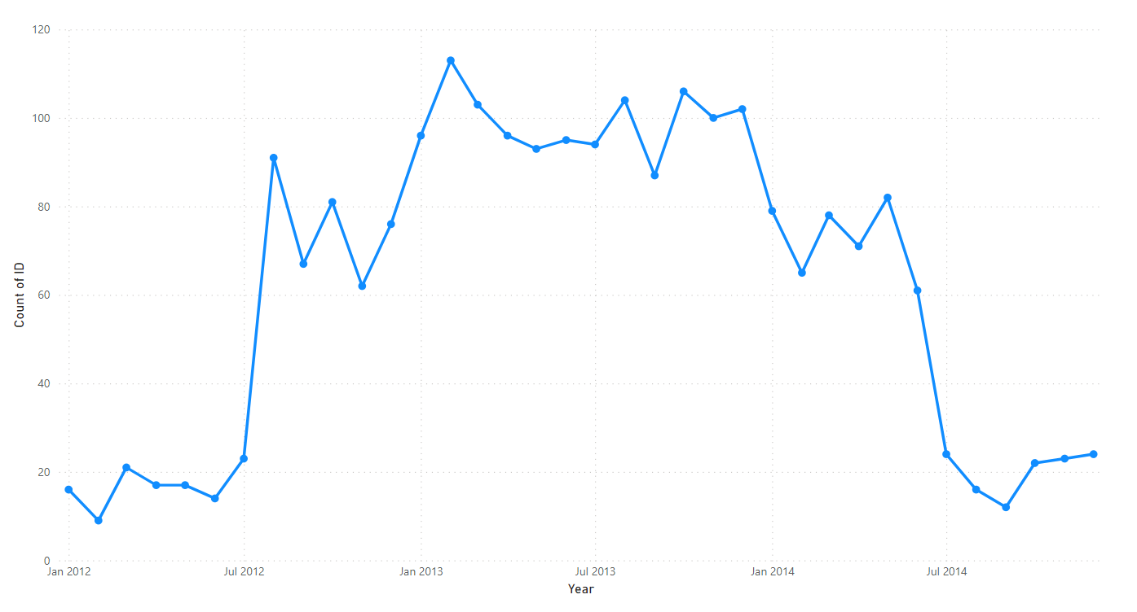
Customer enrollment with the company Trend
Customer enrollment trended up, resulting in a 50.00% increase between January 2012 and December 2014.
Customer enrollment started trending down in April 2014, falling by 66.20% (47) in 8 months
Customer enrollment dropped from 71 to 24 during its steepest decline between April 2014 and December 2014.

Slide 9
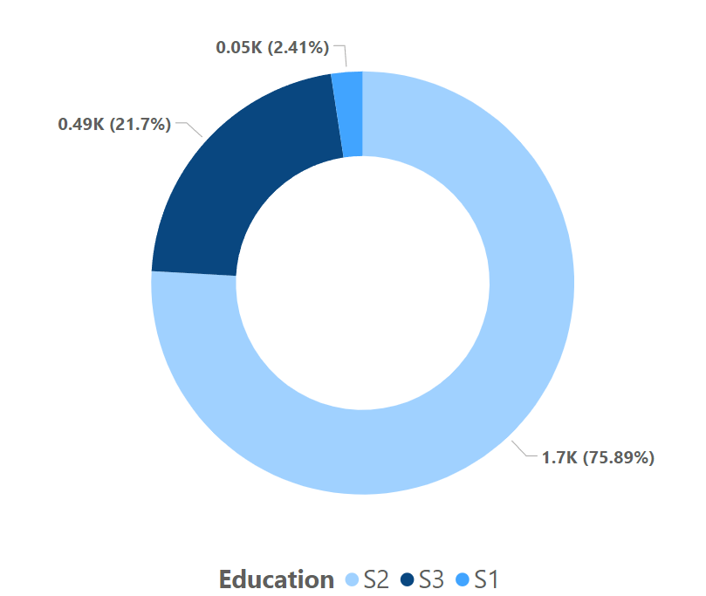
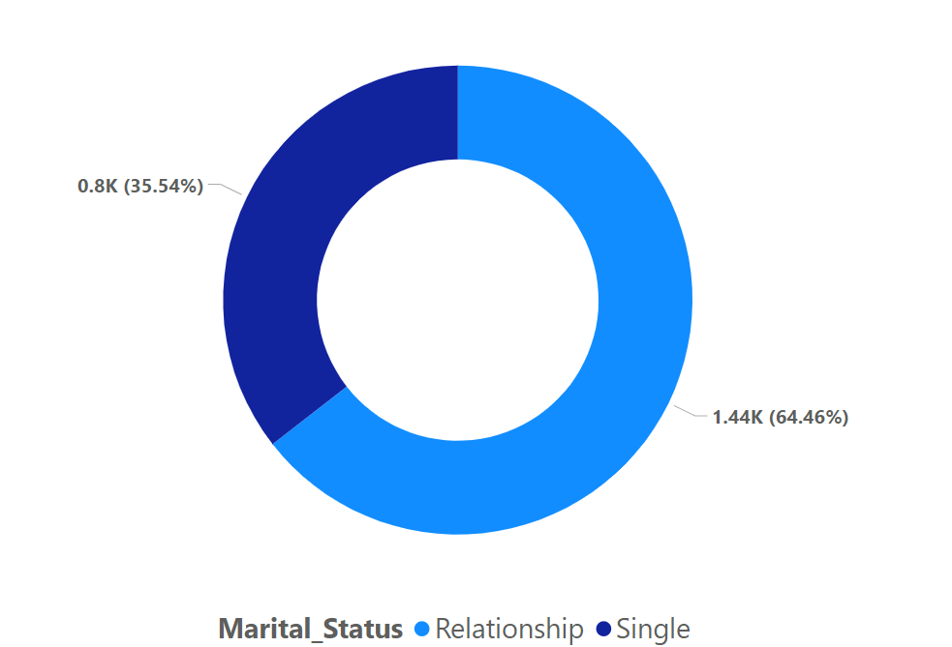
Customer Demographic
Customer Education
Customer Martial Status

Slide 10
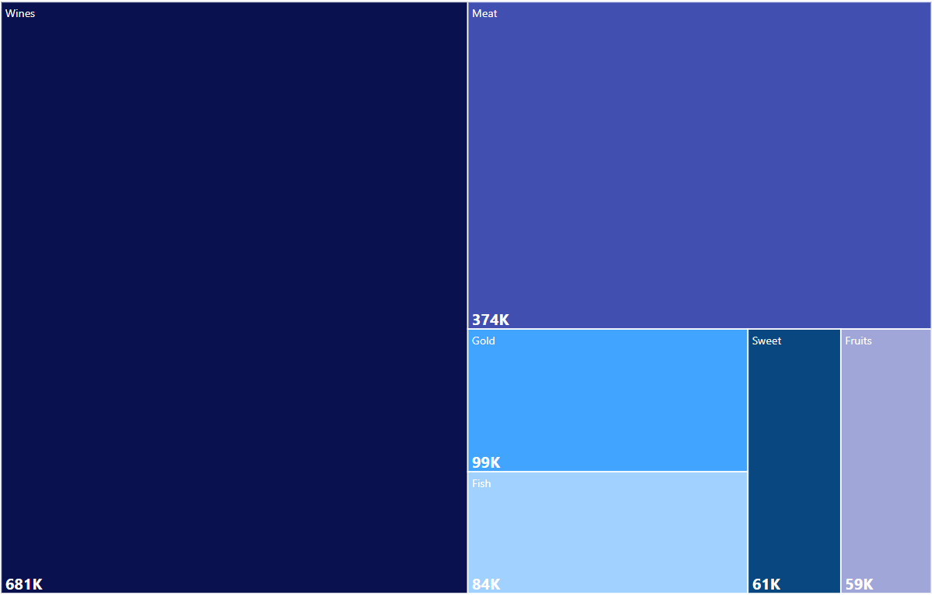
Total Amount of sold each item
Wines Sold Around $681,000
Meat Sold Around $374,000
Gold Sold Around $99,000
Fish Sold Around $84,000
Sweet Sold Around $61,000
Fruits Sold Around $59,000

Slide 11


Data Processing
Fill Median for missing Income
Remove Outliers for Income
Remove Outliers for Age

Slide 12

K-Means Cluster
K-means is a popular unsupervised machine learning algorithm used for clustering data points into groups or clusters. The algorithm takes in a dataset and a specified number of clusters (k) and then partitions the data into k clusters based on their similarity.
The k-means algorithm works by iteratively minimizing the sum of the squared distances between each data point and its assigned centroid, which is the center of the cluster. In each iteration, the algorithm assigns each data point to the nearest centroid, and then updates the centroid by taking the mean of all the data points assigned to it.

Slide 13
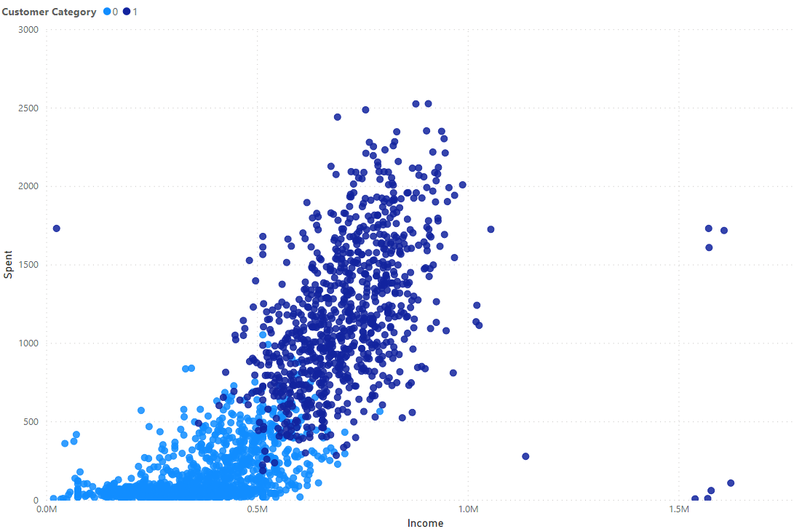
K-means Result
As a result, the First Category are Customer who Customer who has Low income and Low Spent are Sensible Customers.
Otherwise, the Second Category are Customer who Customer who has Low income and High Expenses are Careless Customers.

Slide 14
RFM Analysis
RFM analysis is a marketing technique used to analyze and segment customers based on their purchase behavior. The acronym "RFM" stands for:
  Recency: How recently did the customer make a purchase?
  Frequency: How often does the customer make purchases?
  Monetary: How much does the customer spend on each purchase?
RFM analysis involves assigning scores to each customer based on their recency, frequency, and monetary value, and then grouping them into segments based on these scores. This segmentation allows businesses to target specific groups of customers with tailored marketing strategies, based on their buying behavior.

Slide 15
RFM Analysis Segment
Let’s delve into few interesting segments:
  Champions are the best buyers, who have recently bought, most regularly, and are big spenders. And compensate these clients. For emerging products, they may become early adopters and help market the brand.
  Potential Loyalists are average frequency of your latest consumers and who paid a decent amount. Give or suggest similar items to subscription or loyalty groups to upsell them and make them become the Loyalists or Champions.
  New Customers are The clients who have a high RFM average score but are not regular shoppers. Start building partnerships with these consumers to maximize their visits by offering onboarding assistance and promotional deals.
  At Risk Customers are your clients who ordered regularly and paid significant sums, but lately did not buy. To promote another order, give them customized reactivation campaigns to reconnect, and deliver renewals and beneficial goods.
  Can’t Lose Them are customers who, very frequently, used to visit and order, but have not visited lately. To figure out what went wrong and stop losing them to a rival, get them back with appropriate incentives and run surveys.

Slide 16
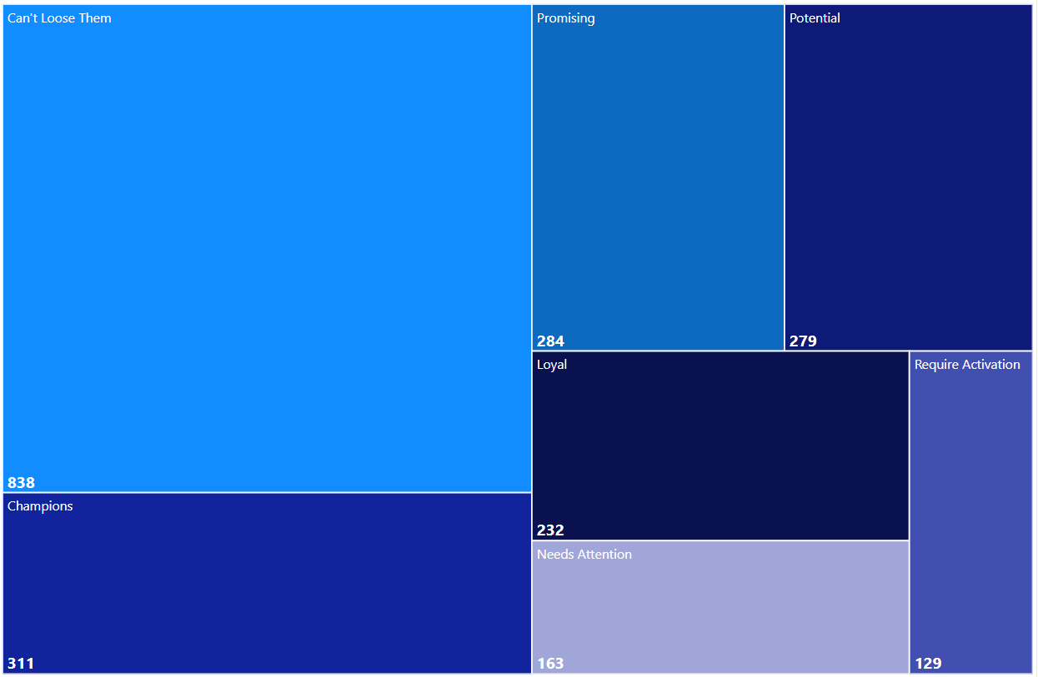
RFM Analysis results
There are 838 customers that need to be maintain
279 Customer have potential to purchase the product from the company
There are 129 new customer that require activation since they have less score

Slide 17
Recommendation
Give Innovation Product or survey for Frequently Customer
Create More Discount or Cashback for Potential Customer
Make a Membership and referral program to increase new customers

Slide 18

THANK YOU!

